Slide 1

Project 2: Sentiment Analysis Using Python API
Jordan Candido, Bailey Carlson, Wesley Osborne, Lucas Nardy, Ashweej Shenoy

Slide 2

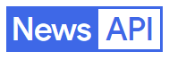


PYTHON API’S USED

Slide 3
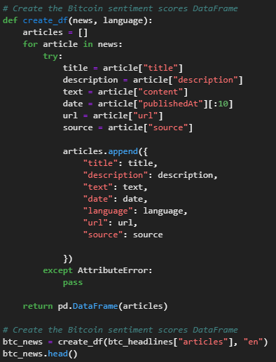
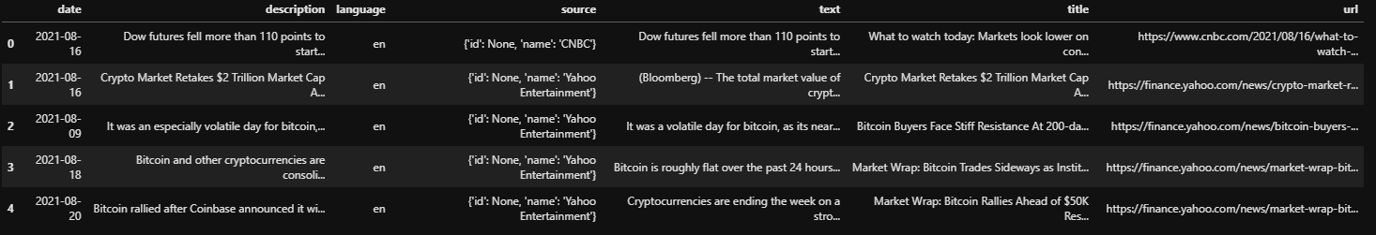
NewsAPI
Expanded on in-class assignment
Consolidated API tools into functions to be used easily
Consolidated search to specific sources
Expanded on stop word list and continuously adding words

Slide 4
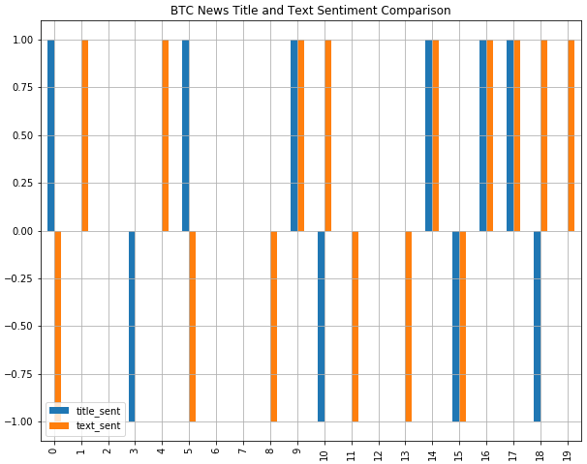
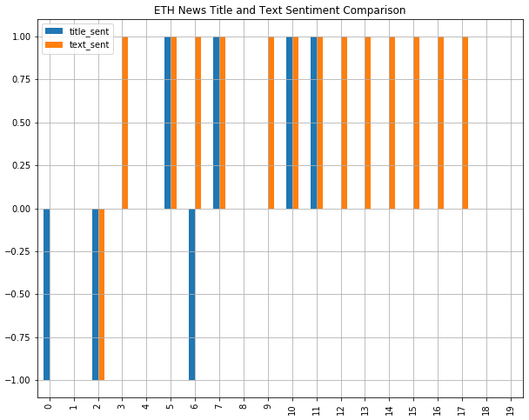
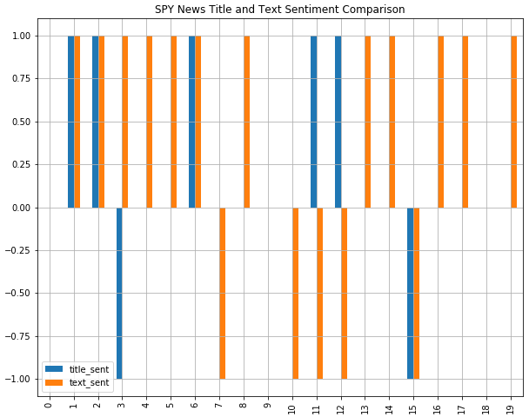
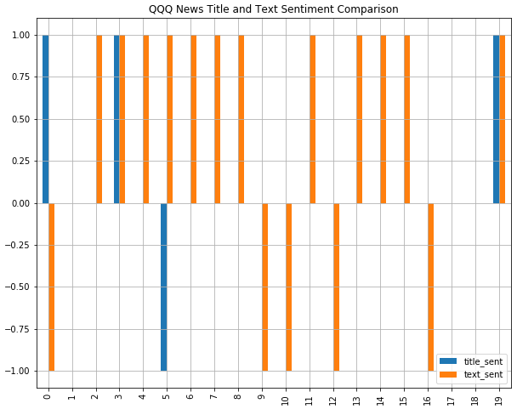
NLP Text and Title Sentiment Scoring

Slide 5
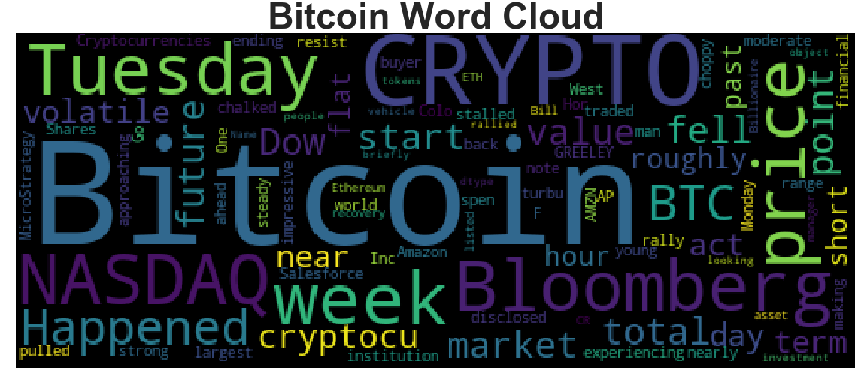
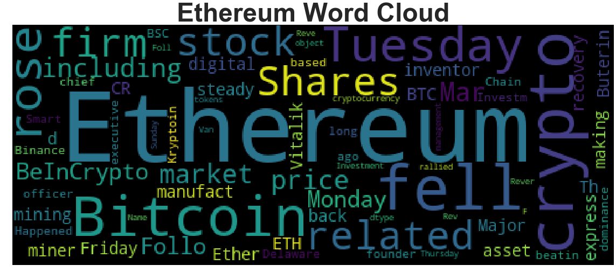
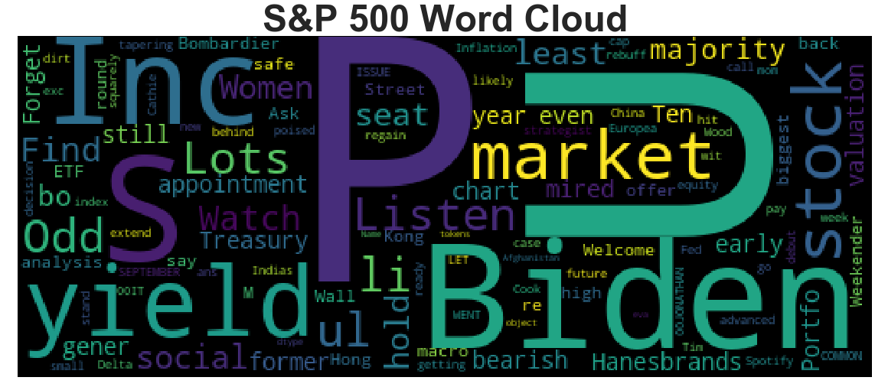
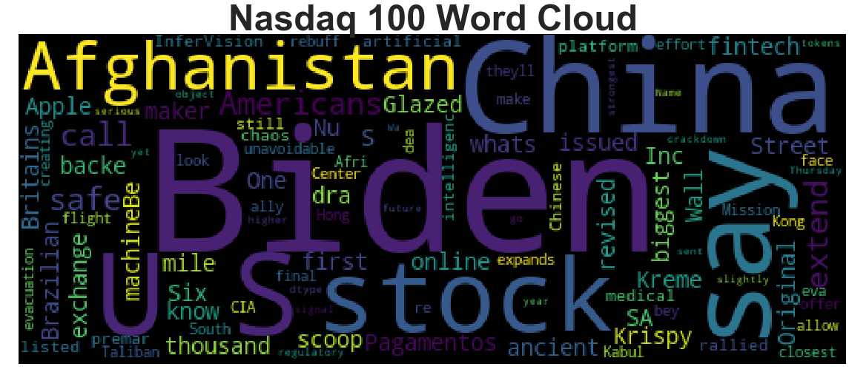
Wordclouds

Slide 6
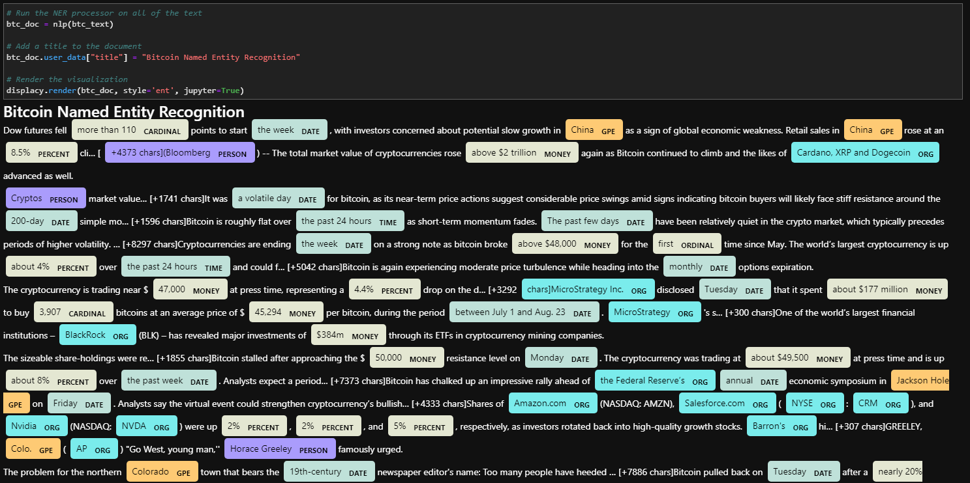
NewsAPI: Named Entity Recognition, Bi-Grams and Key Word Data Frames

Slide 7
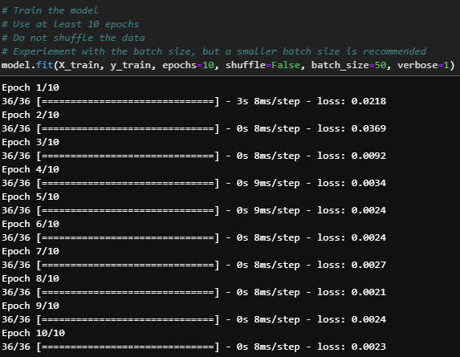
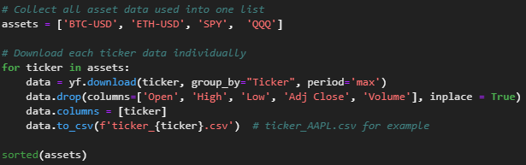
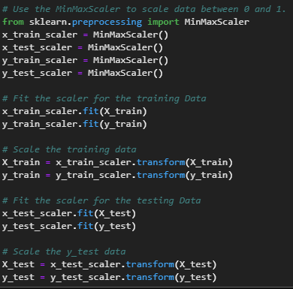
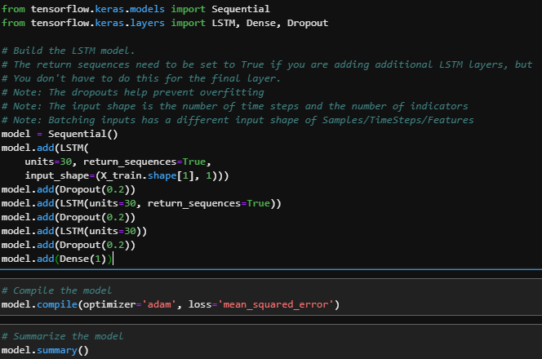
Machine Learning: Price Predictor

Slide 8
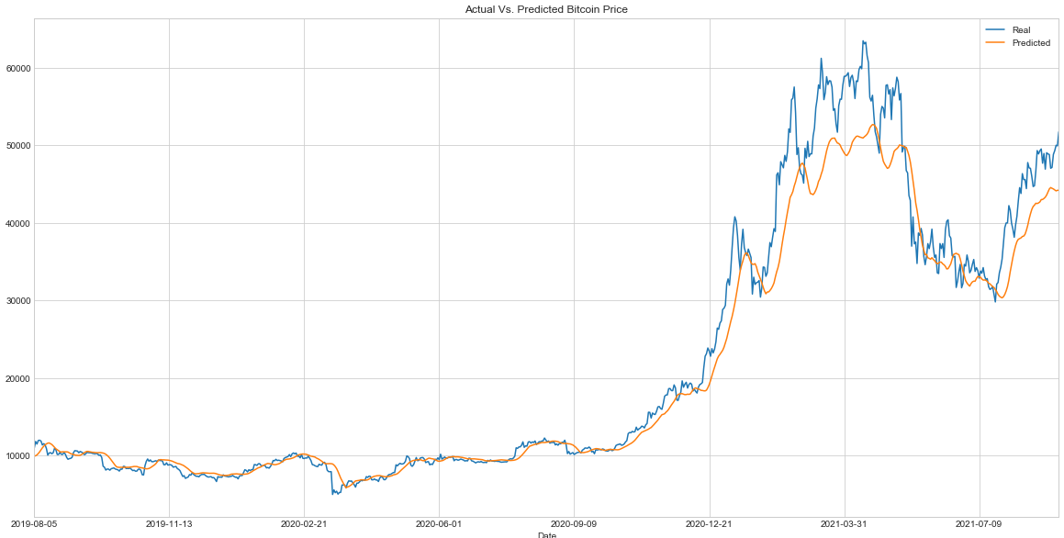
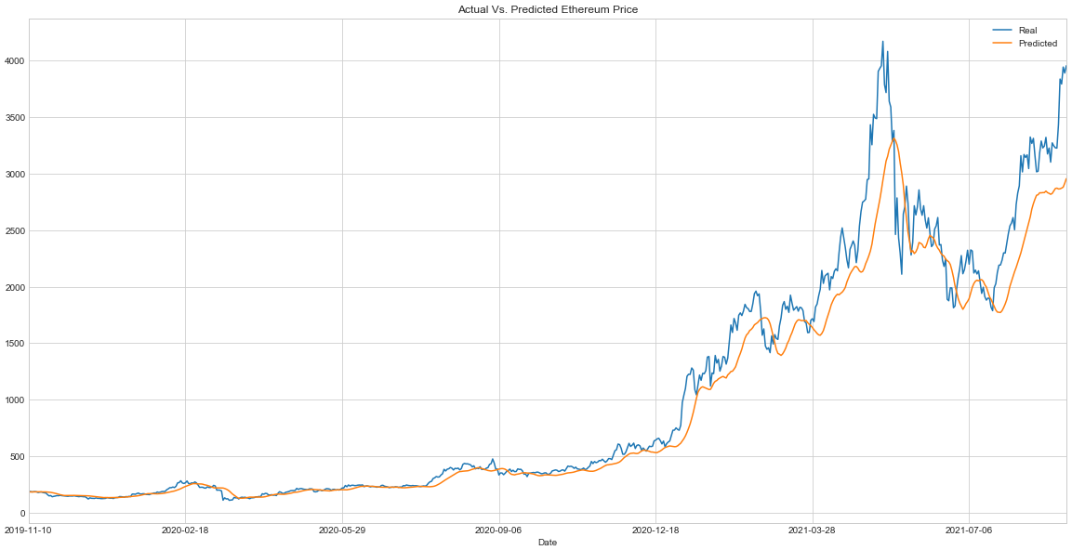
BTC & ETH Price Predictor Models

Slide 9
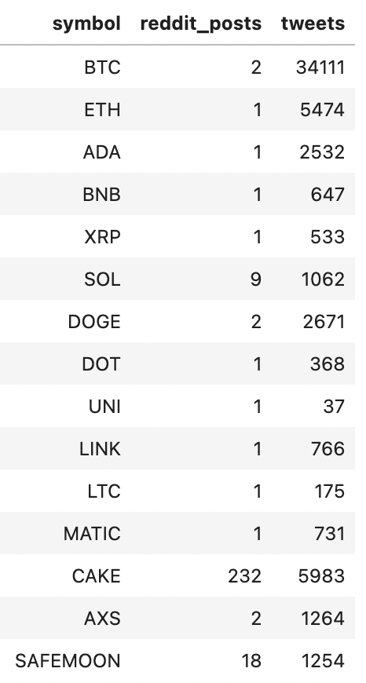
LunarCrush
LunarCrush API: Understand Crypto Transaction by listening to Social Media​
Twitter​
Reddit​
URL Shares​

Slide 10
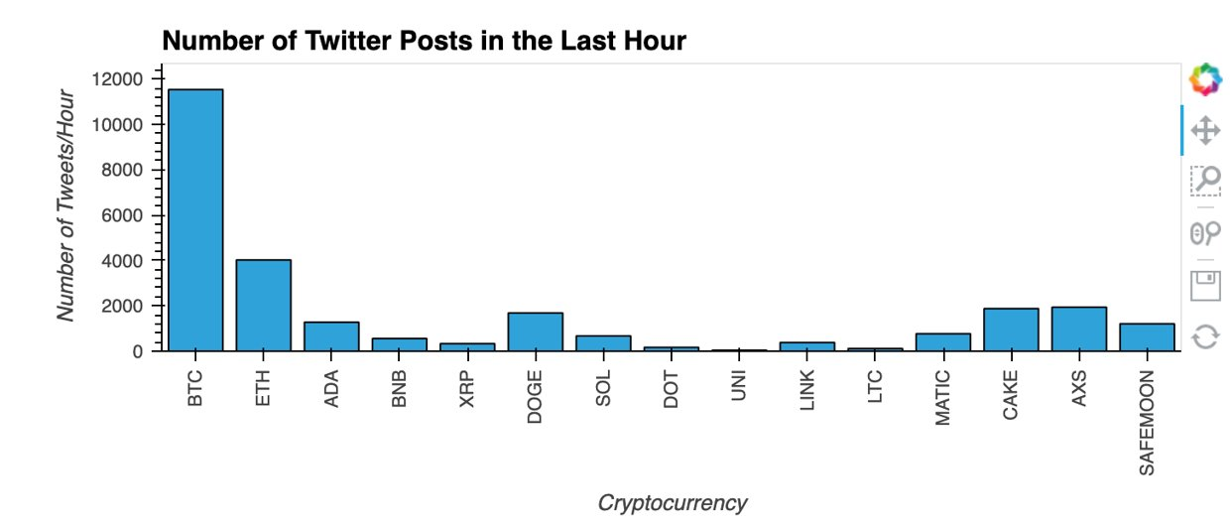
LunarCrush

Slide 11
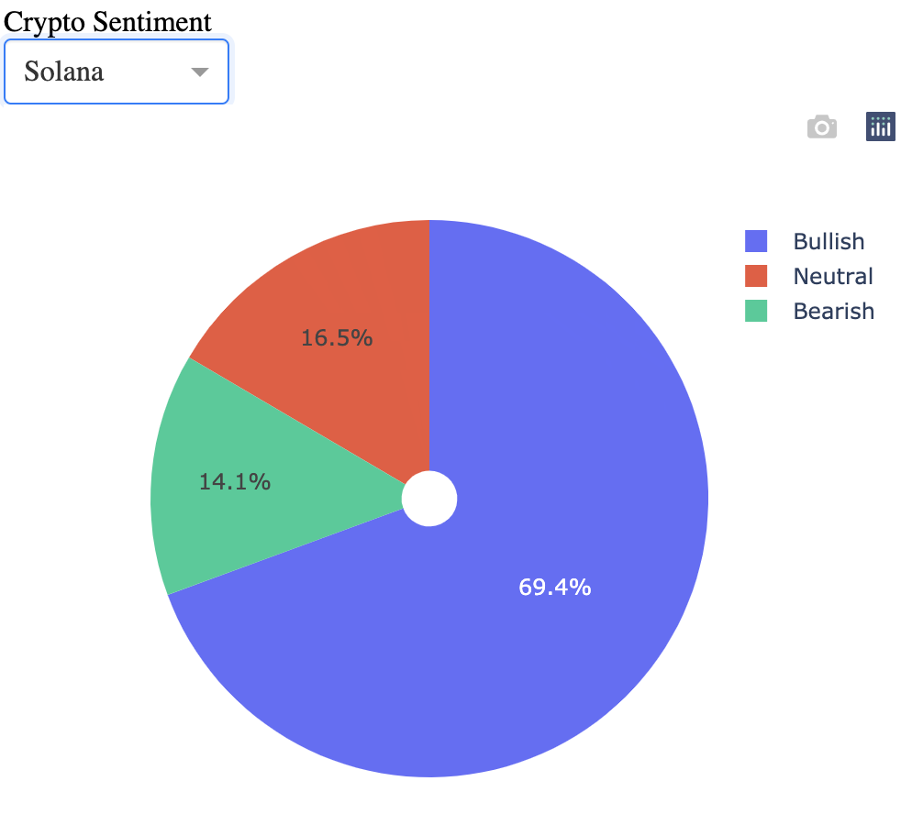
Social Media Sentiment
“Doge is mooning”
Bullish
”ETH is getting REKT”
Bearish
”BTC Shorts are getting REKT”
Bearish

Slide 12
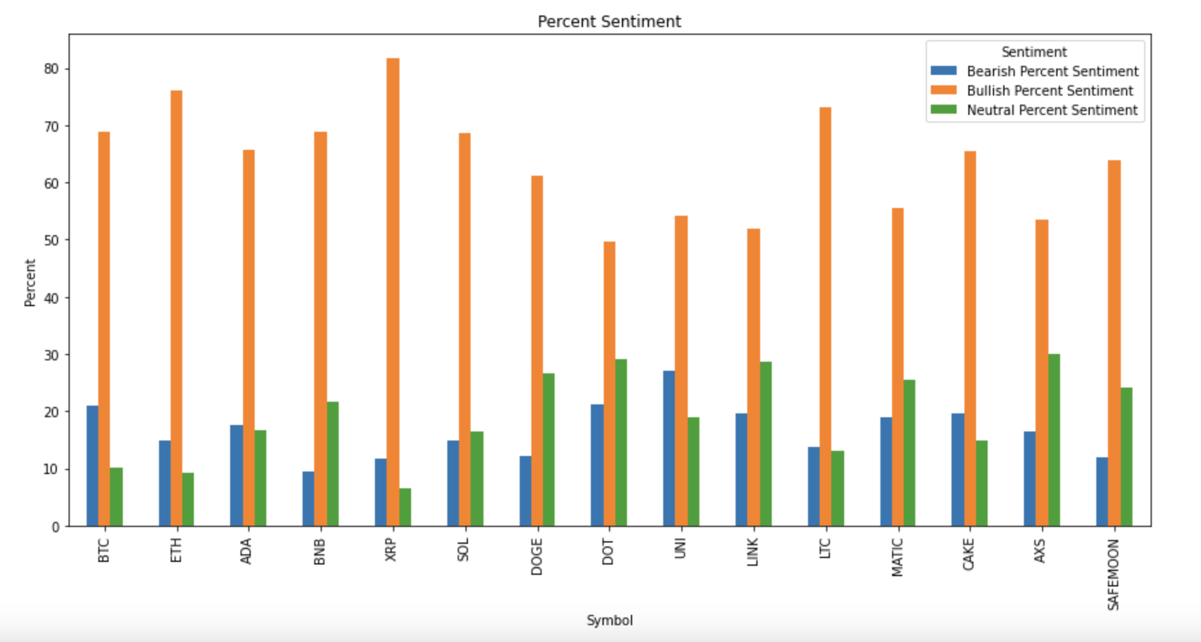
Social Media Sentiment

Slide 13
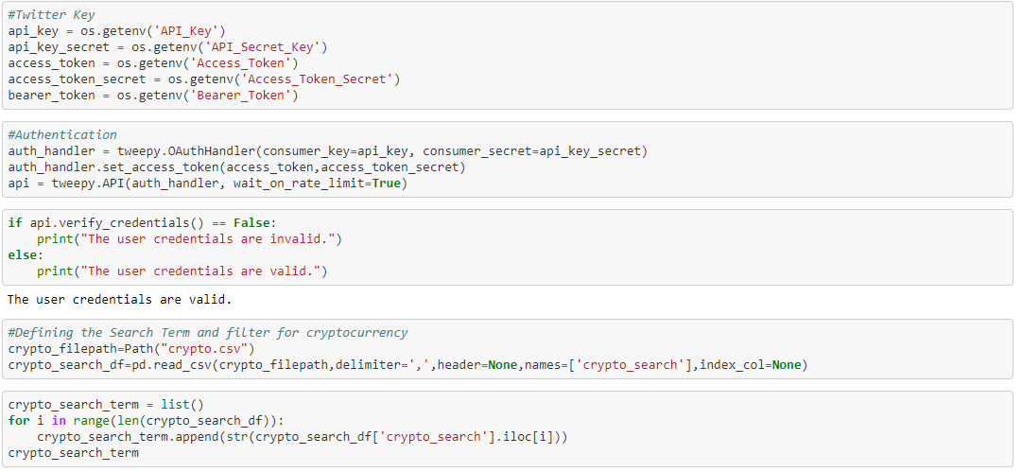
Tweepy
Python library for accessing the Twitter API

Slide 14
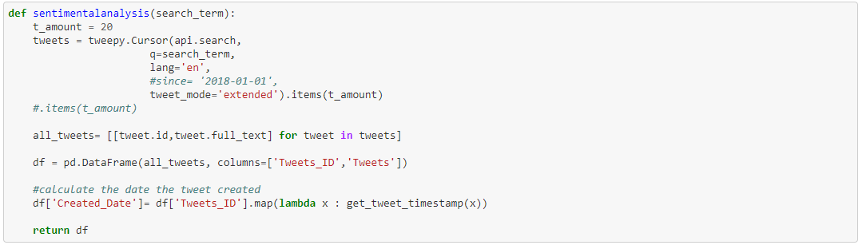
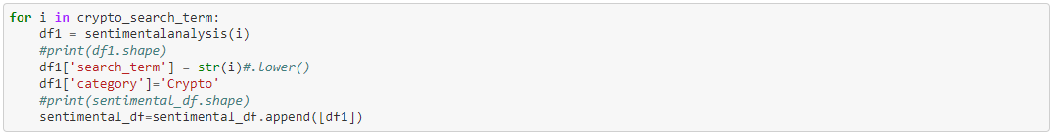
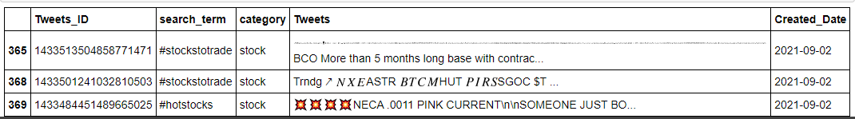
Tweepy

Slide 15
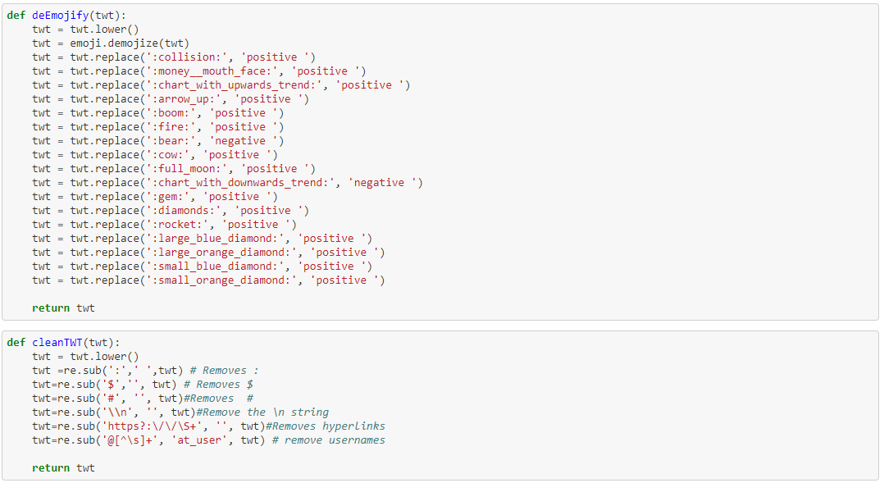
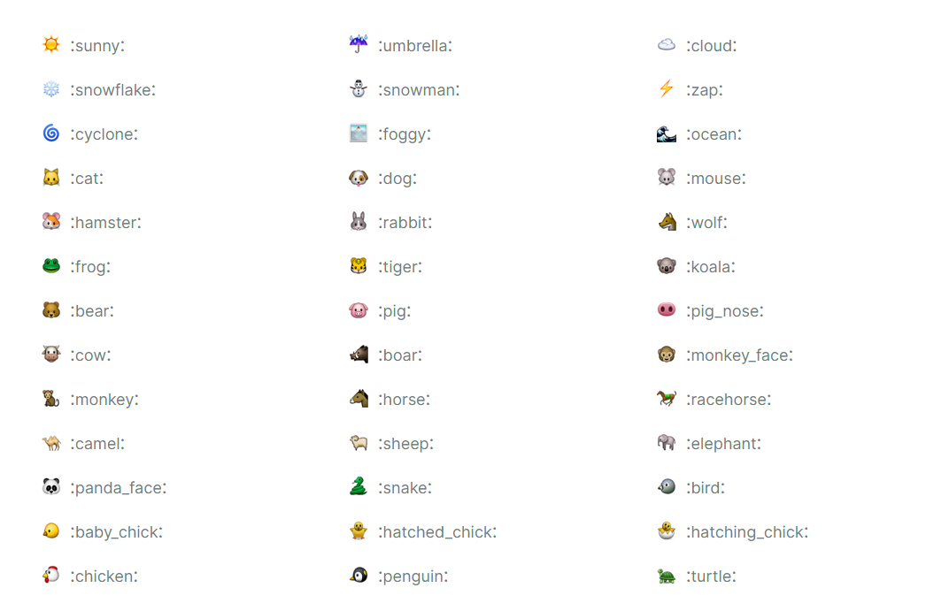
Emoji 1.4.2

Slide 16
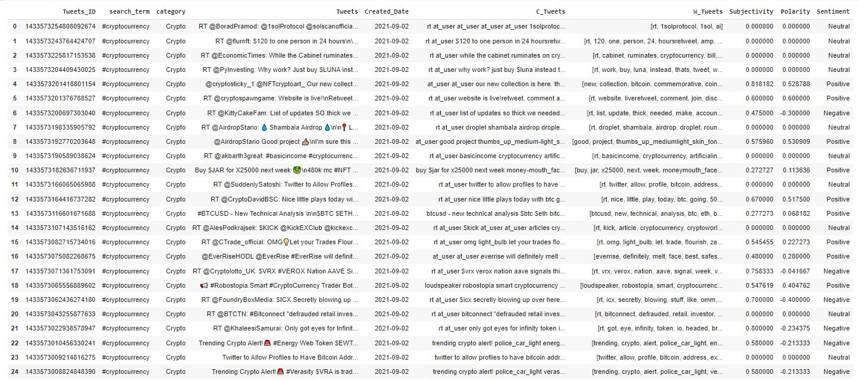
Subjectivity and Polarity Scores

Slide 17
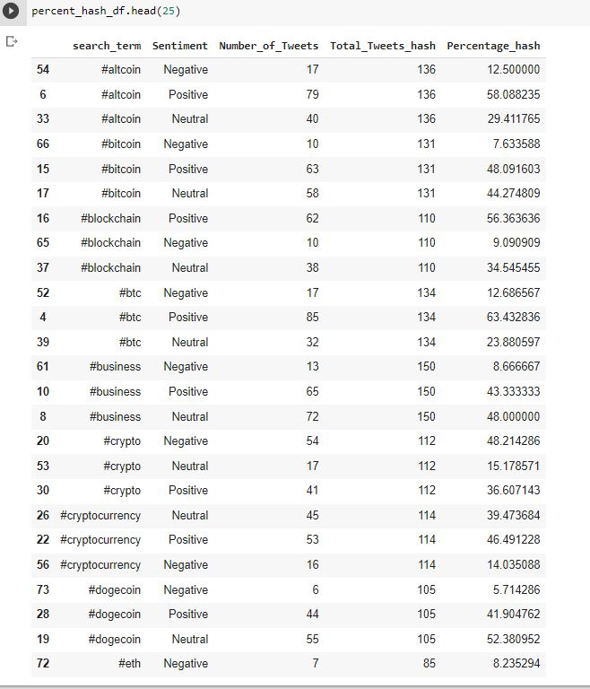
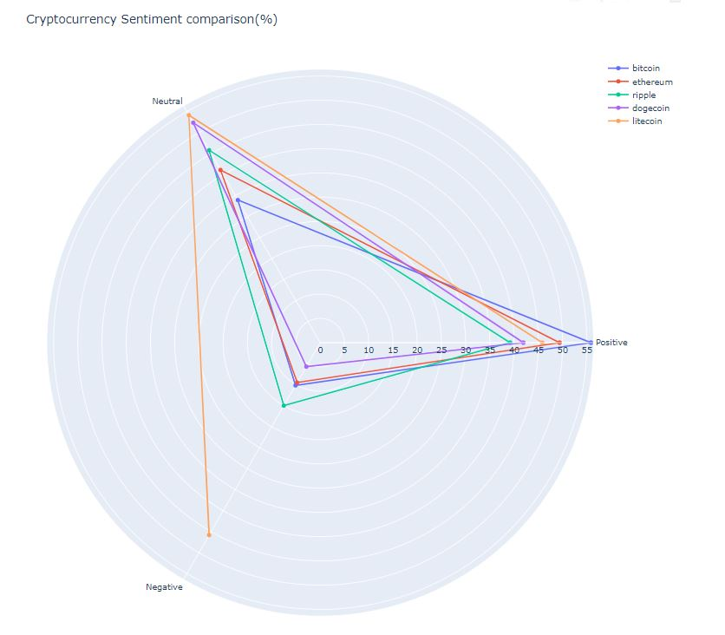
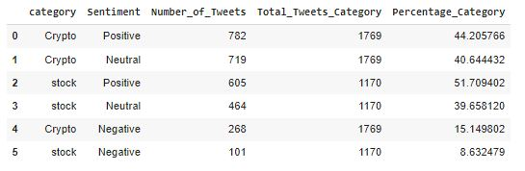
Subjectivity and Polarity Scores

Slide 18
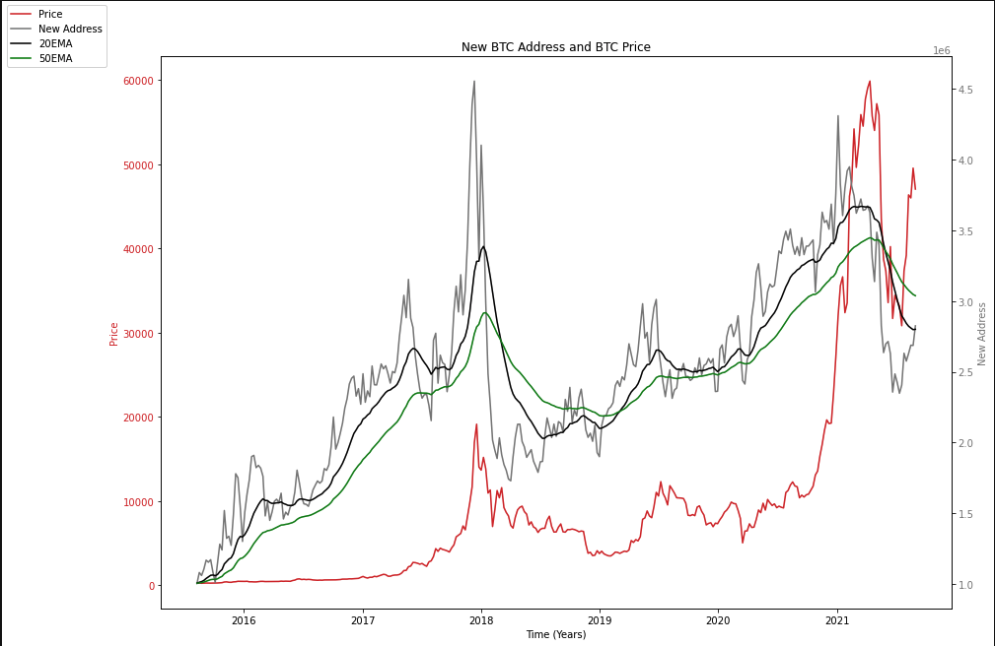
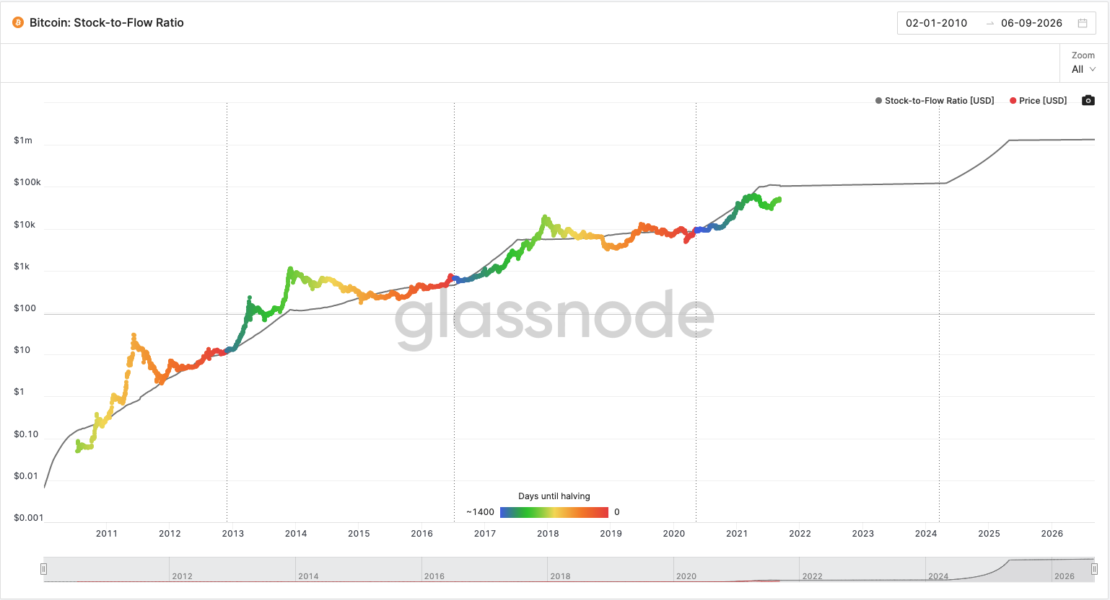
Glassnode and On-chain Metrics
New address created on the BTC chain
Can be used in conjunction to confirm trends and identify ”Euphoria”
Stock to flow is a model derived from the idea that scarcity drives value.
Historically the value has been able to predict the price, but some academics have disproved it.

Slide 19
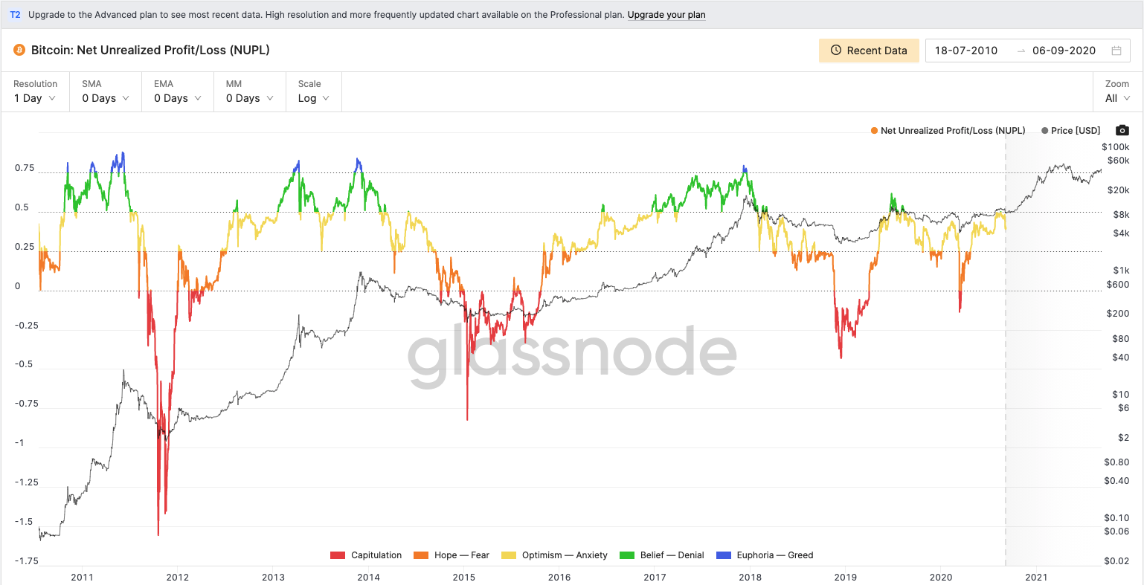
Glassnode and On-chain Metrics: NUPL
NUPL( Net realized profit and loss) shows the profit and loss for all wallets on chain
When the percentage reaches .75 or “Euphoria” we tend to see drop
Stock to flow

Slide 20

Thank you for listening!!!
Questions?

